Slide 1
Chapter 8
Chapters
1. Introduction
2. Graphs
3. Descriptive statistics
4. Basic probability
5. Discrete distributions
6. Continuous distributions
7. Central limit theorem
8. Estimation
9. Hypothesis testing
10. Two-sample tests
13. Linear regression
14. Multivariate regression
Confidence Interval Estimation and Statistical Inference

Slide 2
Statistical Inference…
Statistical inference is the process by which we acquire information and draw conclusions about populations from samples.
In order to do inference, we require the skills and knowledge of descriptive statistics, probability distributions, and sampling distributions.

Slide 3


Estimation
There are two types of inference: estimation and hypothesis testing; estimation is introduced first.
The objective of estimation is to determine the approximate value of a population parameter on the basis of a sample statistic.
E.g., the sample mean ( ) is employed to estimate the population mean ( ).
There are two types of estimators:
Point Estimator
Interval Estimator

Slide 4
Point and Interval Estimator…
A point estimator draws inferences about a population by estimating the value of an unknown parameter using a single value or point.
We saw earlier that point probabilities in continuous distributions were virtually zero. Likewise, we’d expect that the point estimator gets closer to the parameter value with an increased sample size, but point estimators don’t reflect the effects of larger sample sizes. Hence,
An interval estimator draws inferences about a population by estimating the value of an unknown parameter using an interval.
That is we say “with some ___% confidence that the population parameter of interest is between some lower and upper bounds”.

Slide 5

Interval Estimator
The interval is called confidence interval (C.I.).
The chosen probability is called level of confidence.
An interval estimate centered over a point estimate is reported at the endpoints of the range.
Example: Suppose we want to estimate the mean summer income of a class of business students. For n=25 students,
is calculated to be 400 $/week.
point estimate C.I. level of confidence
An alternative statement is:
The mean income is between 380 and 420 $/week with 95% level.

Slide 6


Estimating when is known…
We can calculate an interval estimator from a sampling distribution, by:
Drawing a sample of size n from the population
Calculating its mean,
When X is normally (or approximately normally) distributed then it can be normalized:
And random variable Z will have a standard normal (or approximately normal) distribution!!

Slide 7
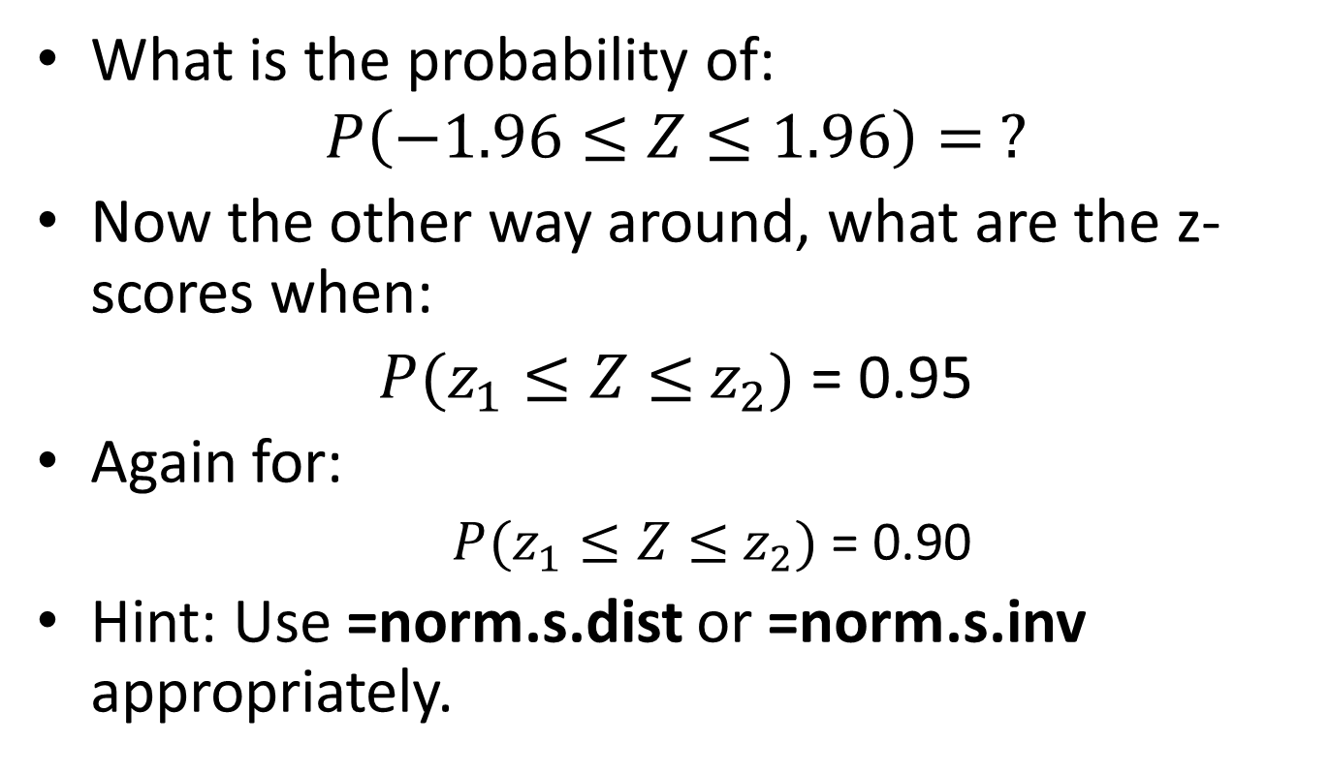
Let’s start easy
What is the probability of:
$$P\left(−1.96≤Z≤1.96\right)= ?$$
Now the other way around, what are the z-scores when:
$P(z_{1}≤Z≤$ $z_{2})$= 0.95
Again for:
$P(z_{1}≤Z≤$ $z_{2})$= 0.90
Hint: Use =norm.s.dist or =norm.s.inv appropriately.

Slide 8
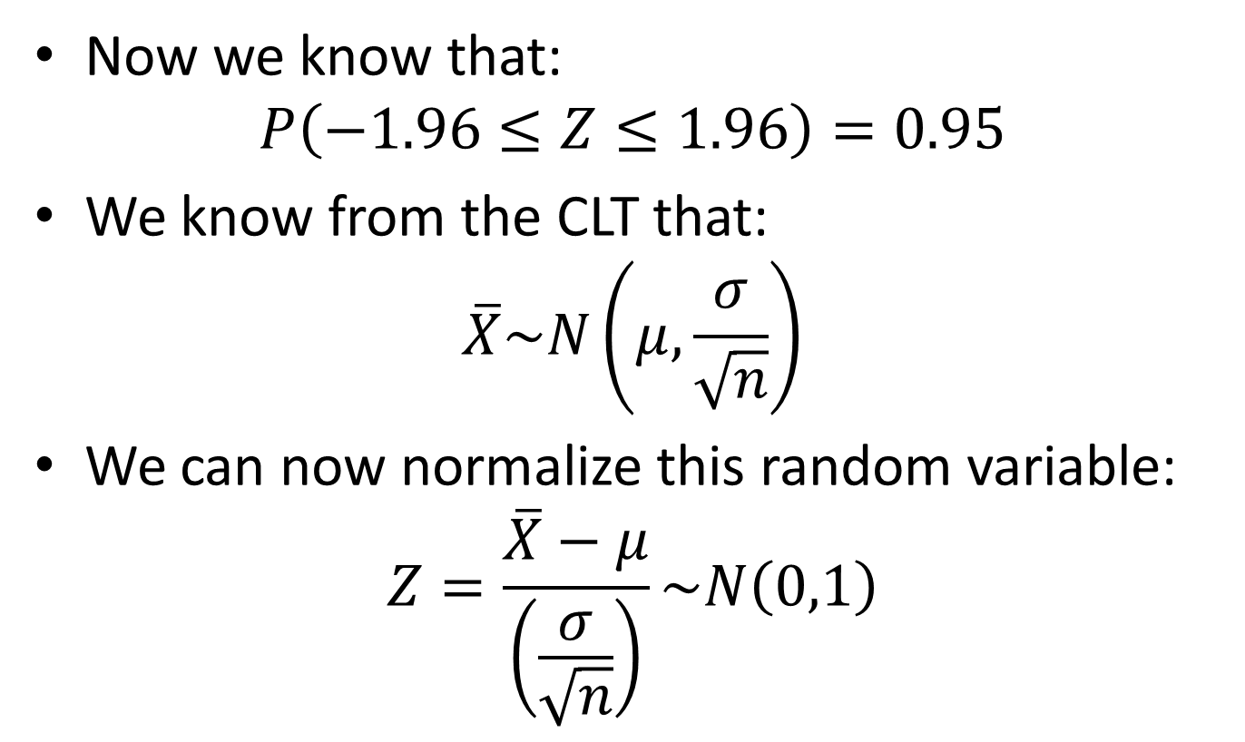
Next steps
Now we know that:
$$P\left(−1.96≤Z≤1.96\right)=0.95$$
We know from the CLT that:
$$\overline{X}\sim N\left(μ,\frac{σ}{\sqrt{n}}\right)$$
We can now normalize this random variable:
$$Z=\frac{\overline{X}−μ}{\left(\frac{σ}{\sqrt{n}}\right)}\sim N\left(0,1\right)$$

Slide 9
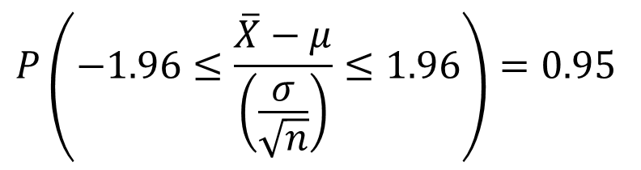
Final steps
Replace Z with the normalized expression:
Now do a bunch of algebra to get:
$$P\left(−1.96≤\frac{\overline{X}−μ}{\left(\frac{σ}{\sqrt{n}}\right)}≤1.96\right)=0.95$$

Slide 10
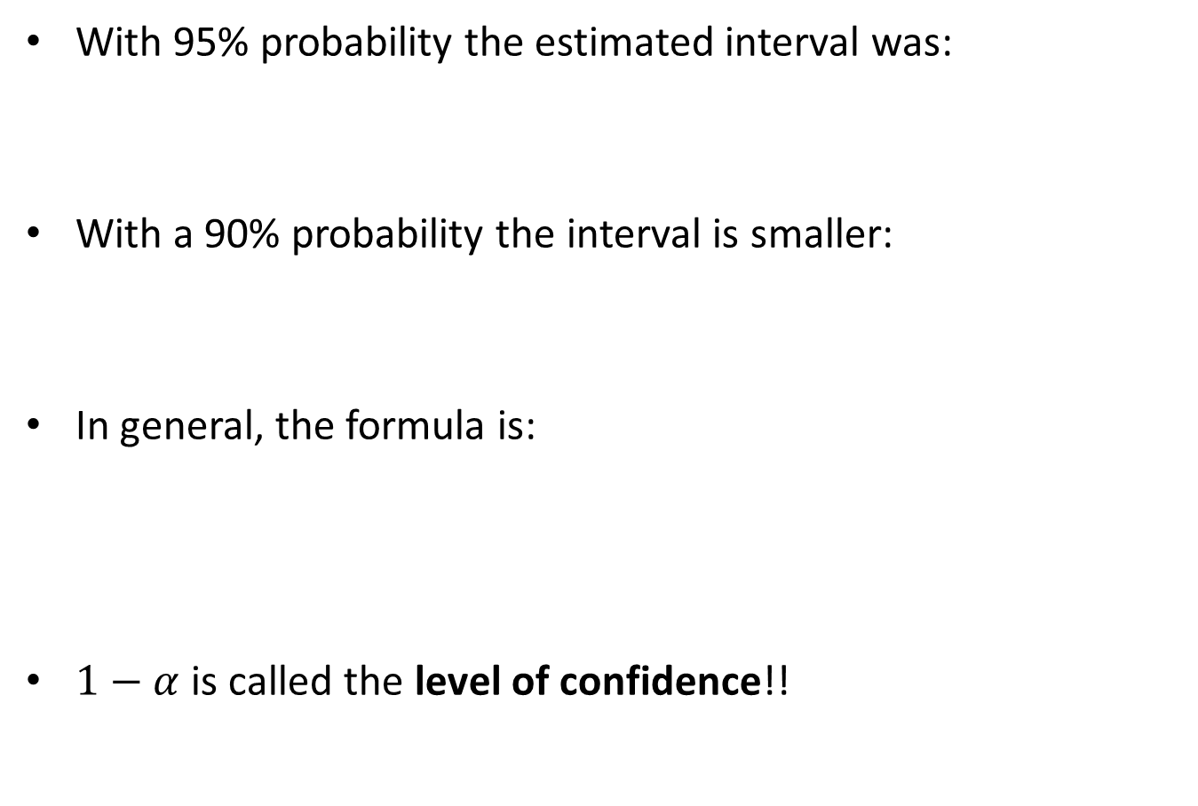
What if we hadn’t started with 95% probability?
With 95% probability the estimated interval was:
With a 90% probability the interval is smaller:
In general, the formula is:
$1−α$ is called the level of confidence!!

Slide 11

Confidence Interval with known $σ$
Confidence interval
True, but unknown parameter
${C.I.}_{.\left(1−α\right)}: \left[\overline{x} ±z_{α/2}\frac{σ}{\sqrt{n}}\right]$ = $\left[\overline{x} −z_{α/2}\frac{σ}{\sqrt{n}},\overline{x}+z_{α/2}\frac{σ}{\sqrt{n}}\right]$

Slide 12

Estimating when is known
Thus, the probability that the interval:
contains the population mean is 1– .
This is a confidence interval estimator for
The confidence interval is abbreviated as: C.I.
$${C.I.}_{.\left(1−α\right)}= \left[\overline{x} −z_{α/2}\frac{σ}{\sqrt{n}},\overline{x}+z_{α/2}\frac{σ}{\sqrt{n}}\right]$$

Slide 13
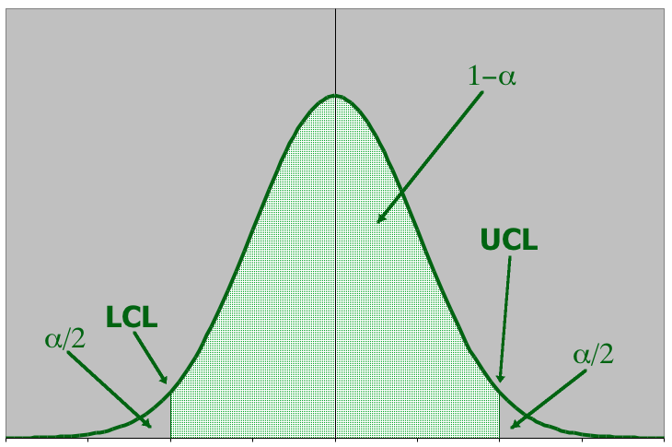


Graphically…
…the actual location of the population mean …
…may be here…
…or here…
…or possibly even here…
The population mean is a fixed but unknown quantity. It’s incorrect to interpret the confidence interval estimate as a probability statement about . . The interval acts as the lower and upper limits of the interval estimate of the population mean.

Slide 14
Notation and Term…
- the probability in tails, the likelihood of a certain type of error or mistake.
level of confidence = 1 –
is called critical value, the z score associated with half of alpha.
is called margin of error, denoted by e.
Therefore, C.I. is the interval [point estimate – e, point estimate + e].

Slide 15
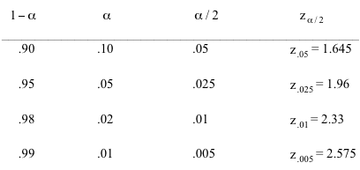
4 Commonly used Confidence Levels…
Confidence Level

cut & keep handy!

Table 10.1

Slide 16
Example
A computer company samples demand during a sales period over 25 sales periods:
Its is known that the standard deviation of demand during a sales period is 75 computers.
We want to estimate the mean demand of a sales period with 95% confidence in order to set inventory levels correctly.

Slide 17



Example
In order to use our confidence interval estimator, we need the following pieces of data:
therefore:
So the 95% C.I. is (340.76, 399.56).
Interpretation: The intervals got in this way contain in 95% of the time.
 | 370.16
 | 1.96
 | 75
n | 25
Calculated from the data…
, from Stats Tables or Excel.
Given

Slide 18
Confidence Interval
A confidence interval either does or does not contain μ.
The confidence level quantifies the risk.
Out of 100 confidence intervals, approximately 95% would contain μ, while approximately 5% would not contain μ.

Slide 19
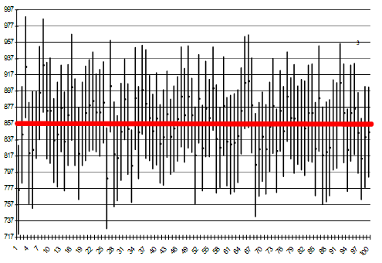
Confidence Interval

Slide 20
Interval Width…
A wide interval provides little information.
For example, suppose we estimate with 95% confidence that an accountant’s average starting salary is between $15,000 and $100,000.
Contrast this with:
a 95% confidence interval estimate of starting salaries between $42,000 and $45,000.
The second estimate is much narrower, providing accounting students more precise information about starting salaries.

Slide 21
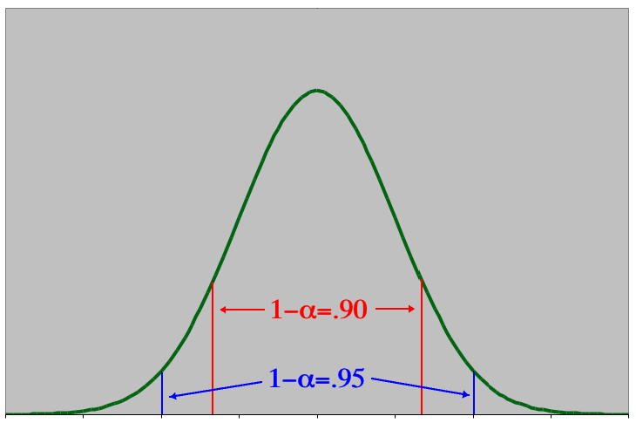
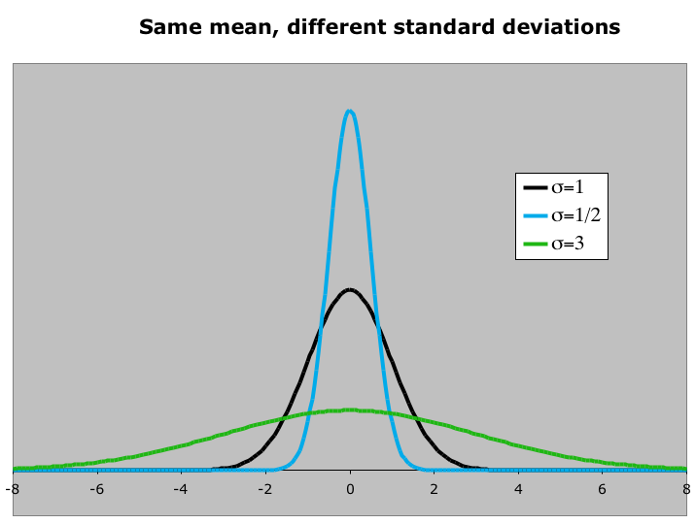

Interval Width…
A larger confidence level produces a w i d e r confidence interval
Larger values of produce w i d e r confidence intervals
Increasing the sample size decreases the width of the confidence interval while the confidence level can remain unchanged.
More data provides better estimates

Slide 22



Selecting the Sample Size!
We can control the width of the interval by determining the sample size necessary to produce narrow intervals.
Suppose we want to estimate the mean demand “to within 5 units”; i.e. we want the interval estimate to be:
Since:
It follows that
that is, to produce a 95% confidence interval estimate of the mean (±5 units), we need to sample 865 lead time periods (vs. the 25 data points we have currently).
Solve for n to get required sample size!

Slide 23


Sample Size to Estimate a Mean…
The general formula for the sample size needed to estimate a population mean with an interval estimate of:
Requires a sample size of at least this large:

Slide 24
Example: Margin of Error
A lumber company must estimate the mean diameter of trees to determine whether or not there is sufficient lumber to harvest an area of forest.
They need to estimate this to within 1 inch at a confidence level of 99%.
The tree diameters are normally distributed with a standard deviation of 6 inches.
How many trees need to be sampled?

Slide 25


Example
Things we know:
Confidence level = 99%,
therefore =.01
We want ,
hence W=1.
We are given that = 6.
We compute…
That is, we will need to sample at least 239 trees to have a 99% confidence interval of
1
1

Slide 26



Inference with unknown variance!
Previously, we estimate the population mean when the population standard deviation was known or given.
When is unknown, we use its point estimator s
and the z-statistic is replaced by the t-statistic, where the number of “degrees of freedom” v = n–1.
NOTE: To use “z” or “t”, we require X-bar has NORMAL distribution.

Slide 27

Estimating when is unknown!
When the population standard deviation is unknown and the population is normal, the statistic is:
which is Student t distributed with v= n–1 degrees of freedom. The confidence interval estimator of is given by:

Slide 28

Estimating when is unknown
Thus, the probability that the interval:
contains the population mean is 1– .
This is a confidence interval estimator for
Use =t.inv to get the critical t scores.
$${C.I.}_{.\left(1−α\right)}= \left[\overline{x} −t_{α/2}\frac{s}{\sqrt{n}},\overline{x}+t_{α/2}\frac{s}{\sqrt{n}}\right]$$

Slide 29
Example
A random sample of n = 83 companies resulted in average sales of $15.02 with a variance of 68.98.
Please construct an interval estimator for average sales with a 95%.

Slide 30




Example
From the data, we calculate:
For this term
and so:
We are confident that 95% of similarly constructed confidence intervals contain the true population mean.
=T.INV(0.025,82)

Slide 31
Reminder on using Excel
To get the negative z value that has the specified probability to the left:
t1=t.inv(,n-1)
P(T<t1)= 
t1=t.inv(,n-1)

Slide 32
Optional Material

Slide 33
Inference: Population Proportion…
When data are nominal, we count the number of occurrences of each value and calculate proportions.
Thus, the parameter of interest in describing a population of nominal data is the population proportion π.
This parameter is based on the binomial experiment.
Recall the use of this statistic:
where p is the sample proportion: x successes in a sample size of n items.

Slide 34
Inference: Population Proportion…
When nπ and n(1–π) are both at least 5, the sampling distribution of p is approximately normal with:
Thus,
The confidence interval estimator for π is given by:

Slide 35
Selecting the Sample Size…
The confidence interval estimator for a population proportion is:
Thus the (half) width of the interval (W) is:
Solving for n, we have:

Slide 36
Selecting the Sample Size…
For example, we want to know how many customers to survey in order to estimate the proportion of customers who prefer our brand to within 0.03 (with 95% confidence).
i.e. our confidence interval after surveying will be p ± 0.03, that means W=0.03
Substituting into the equation…
Uh Oh. Since we haven’t taken a sample yet, we don’t have this sample proportion…

Slide 37
Selecting the Sample Size…
Two methods – in each case we choose a value for p then solve the equation for n.
Method 1 : no knowledge of even a rough value of p. This is a ‘worst case scenario’ so we substitute: p= 0.50
Method 2 : we have some idea about the value of p. This is a better scenario and we substitute in our estimated p value.
e.g. We draw a sample and get a p, then we can use this p to solve for n for the next sample that would give us the interval estimate with the required probability.

Slide 38


Selecting the Sample Size…
Method 1 : no knowledge of value of p, use 50%:
Method 2 : p from last sample is, say, 20%:
Thus, we can sample fewer people if we already have a reasonable estimate of the population proportion before starting.

Slide 39
Practice
A Gallup Poll released stated with 95% confidence that the proportion of Marylanders supporting President Bush's proposal for revising Social Security was 56% with a margin of error of 3%. The number of persons polled was 1052.
Verify this result.

Slide 40
Solution
Step One: Identify the Random Variable: p
Center: p=0.56
Step Two: Determine Its Distribution
Standard Error: SQRT(0.56*0.44/1052)=0.0153
Shape: 0.56*1052 = 589>5, and
0.44*1052 = 463>5 ==>Normal
Margin of Error:
0.56+-NORM.S.INV(0.025)*0.0153=0.56+-0.03

Slide 41
Example Extended
Estimate the two values between which 99.7% of similar sample proportions might lie.
0.56+-NORM.S.INV(0.0015)*0.0153=0.56+-4.54
So the interval increased in size, because the probability that this interval covers the true population proportion is larger.

